Slide 1
ViralGeneClock A Tool for Estimating the Relative Mutation Rate of Different Genes across Viral Strains using Phylogenetic Analyses.
- Merit Kayastha

Slide 2
Background
­ViralGeneClock is a web application, where the users can submit the FASTA sequence of viral strains, and get the outputs emailed to their address.
ViralGeneClock utilizes the Neighbor-joining (NJ) algorithm for phylogenetic analyses.
NJ is a bottom-up clustering method for estimating genetic distances and branch lengths, and creating phylogenetic trees.

Slide 3
Rationale
Identify regions of the viral genome that are highly conserved across different strains. Could be potentially useful for drug/vaccine design.
Understand the phylogenetic relationship between different strains of the virus.
Identify regions with rapid mutation, indicating that the region is under strong selective pressure.

Slide 4
Tools and Materials
Prokka
- A Linux-based rapid prokaryotic genome annotation tool, for viral annotation.
MUSCLE
Multiple sequence alignment tool which uses progressive alignment algorithm.
Biopython: to manage and organize FASTA files.
Flask: wrap the CLI with a user friendly web framework.
Flask-mail: to automatically email users with results once the analysis is complete.
Matplotlib: for generating a phylogenic tree image file.
HTML and CSS: for designing front end and different tabs of the webpage.
Ajax in JavaScript: to retrieve live updates from the command line.

Slide 5
Methods
Full Sequence Analysis
Genome Annotation & Multiple Sequence Alignment
Neighbor-Joining Algorithm to calculate genetic distance and branch length to reference strain.
Gene Analysis
Gene Grouping & Multiple Sequence Alignment for each Gene
NJ algorithm to calculate genetic distance to reference strain for a gene.
Estimation of Relative Mutation Rate.

Slide 6
Tool Workup (Video)
https://ramapo.yuja.com/V/Video?v=10349598&node=44630422&a=161497724

Slide 7
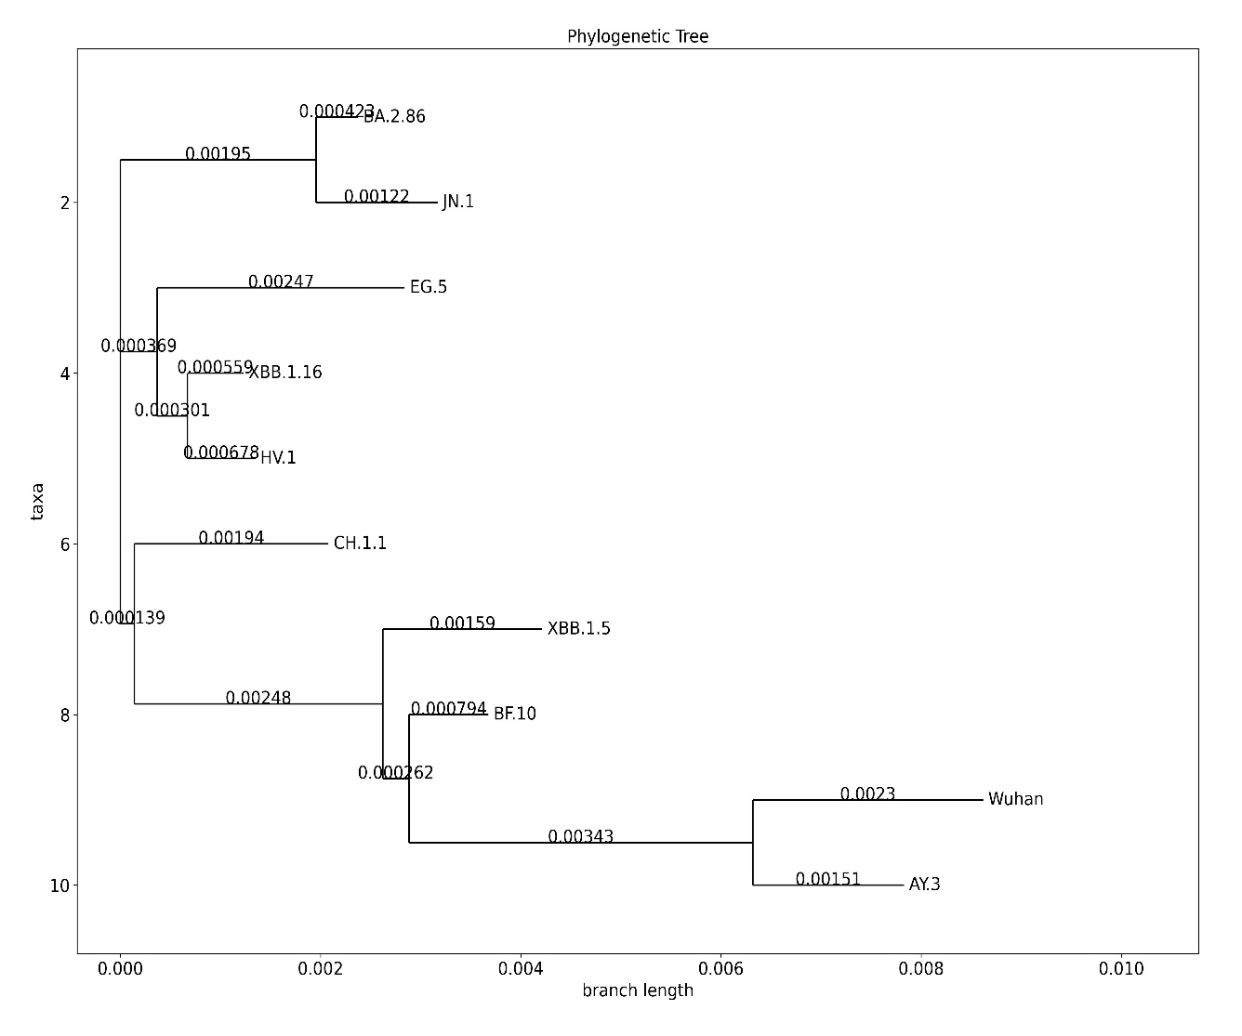
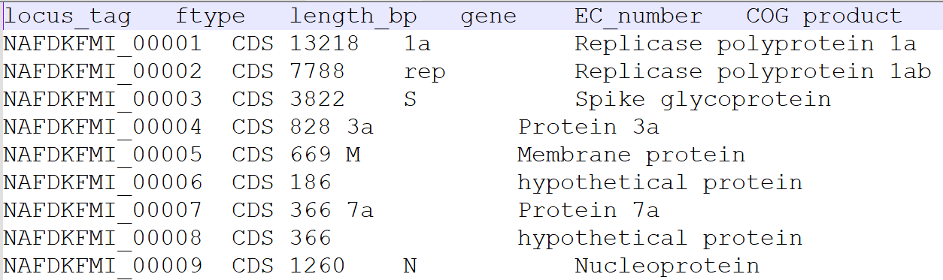
Results
Sample 1: 10 SARS-CoV-2 viral strains
Fig 1: Prokka annotation of SARS-CoV-2 virus.
Fig 2: Phylogenic tree of SARS-CoV-2 viral strains.

Slide 8
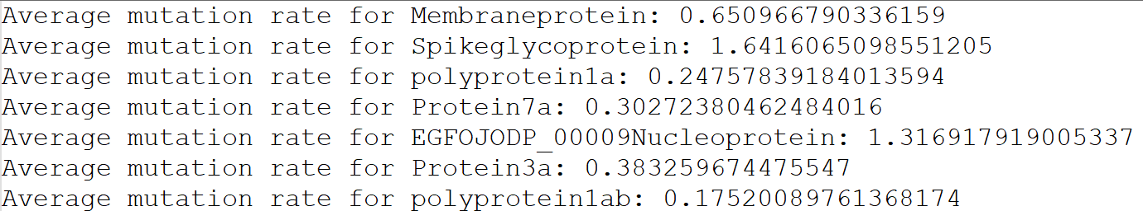
From scientific literature, S and N genes have been found with the highest mutational range.
- Mutation in S protein can alter its binding affinity with the ACE2 receptor, which increases the virus’s ability to evade the immune responses.
- the N protein is responsible for packaging the viral RNA and influences the detection of the virus by the immune system.
Fig 3: Relative mutation rate for annotated genes in SARS-CoV-2 from ViralGeneClock.

Slide 9
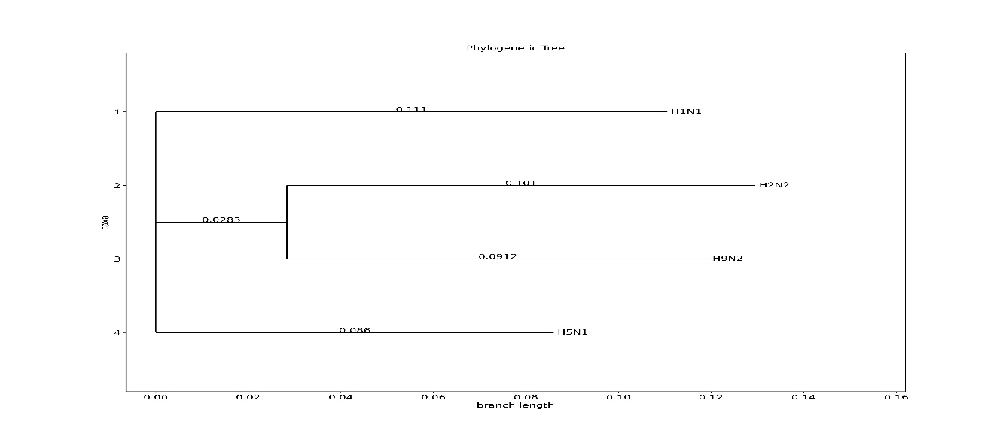
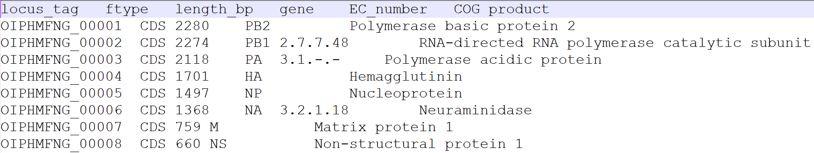
2) Sample 2: 4 Influenza A viral strains.
Fig 4: Prokka annotation of Influenza A virus.
Fig 5: Phylogenic tree of Influenza A viral strains.

Slide 10
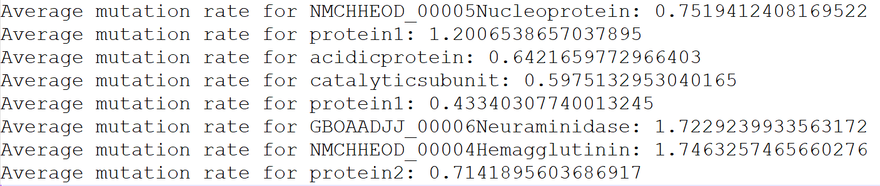
From scientific literature, Hemagglutinin and Neuraminidase genes have been found to evolve more rapidly.
Surface protein genes HA and NA evolve rapidly than internal protein genes.
HA, in particular, helps in attaching to and entering the cells in the respiratory tract, and regular mutations in the HA gene help the virus evade the immune response.
Fig 6: Relative mutation rate for annotated genes in Influenza A from ViralGeneClock.

Slide 11
Conclusion
With a lack of literature on quantitative mutation rates across different genes in viral strains, verifying the accuracy of ViralGeneClock's quantitative relative mutation rates is difficult. However, the tool’s findings align with the qualitative information in the literature, as observed in the examples of SARS-CoV-2, HIV-1, and Influenza 1.
ViralGeneClock is effective in identifying the evolutionary relationship between different viral strains and can be utilized for pinpointing viral regions with varying levels of conservation.

Slide 12
References:
Cardona-Ospina, J. A., Rojas-Gallardo, D. M., Garzón-Castaño, S. C., Jiménez-Posada, E. V., & Rodríguez-Morales, A. J. (2021). Phylodynamic analysis in the understanding of the current COVID-19 pandemic and its utility in vaccine and antiviral design and assessment. Human Vaccines & Immunotherapeutics, 17(8), 2437–2444. https://doi.org/10.1080/21645515.2021.1880254
Hegde, S., Tang, Z., Zhao, J., & Wang, J. (2021). Inhibition of SARS-CoV-2 by targeting conserved viral RNA structures and sequences. Frontiers in Chemistry, 9. https://doi.org/10.3389/fchem.2021.802766
Saitou, N., & Nei, M. (1987). The neighbor-joining method: a new method for reconstructing phylogenetic trees. Molecular Biology and Evolution, 4(4), 406–425. https://doi.org/10.1093/oxfordjournals.molbev.a040454
Kuhner, M. K., & Felsenstein, J. (1994). A simulation comparison of phylogeny algorithms under equal and unequal evolutionary rates. Molecular Biology and Evolution, 11(3), 459–468. https://doi.org/10.1093/oxfordjournals.molbev.a040126
Seemann, T. (2014). Prokka: rapid prokaryotic genome annotation. Bioinformatics (Oxford, England), 30(14), 2068–2069. https://doi.org/10.1093/bioinformatics/btu153
Hyatt, D., Chen, G.-L., LoCascio, P. F., Land, M. L., Larimer, F. W., & Hauser, L. J. (2010). Prodigal: prokaryotic gene recognition and translation initiation site identification. BMC Bioinformatics, 11(1). https://doi.org/10.1186/1471-2105-11-119
Edgar, R. C. (2004). MUSCLE: multiple sequence alignment with high accuracy and high throughput. Nucleic Acids Research, 32(5), 1792–1797. https://doi.org/10.1093/nar/gkh340
Cock, P. J. A., Antao, T., Chang, J. T., Chapman, B. A., Cox, C. J., Dalke, A., Friedberg, I., Hamelryck, T., Kauff, F., Wilczynski, B., & de Hoon, M. J. L. (2009). Biopython: freely available Python tools for computational molecular biology and bioinformatics. Bioinformatics (Oxford, England), 25(11), 1422–1423. https://doi.org/10.1093/bioinformatics/btp163
Flask. Readthedocs.org. Retrieved April 6, 2024, from https://readthedocs.org/projects/flask/
Flask-mail — Flask-Mail 0.9.1 documentation. Pythonhosted.org. Retrieved May 1, 2024, from https://pythonhosted.org/Flask-Mail/
AJAX introduction. W3schools.com. Retrieved May 1, 2024, from https://www.w3schools.com/js/js_ajax_intro.asp
Hirabara, S. M., Serdan, T. D. A., Gorjao, R., Masi, L. N., Pithon-Curi, T. C., Covas, D. T., Curi, R., & Durigon, E. L. (2022). SARS-COV-2 variants: Differences and potential of immune evasion. Frontiers in Cellular and Infection Microbiology, 11. https://doi.org/10.3389/fcimb.2021.781429
Cuevas, J. M., Geller, R., Garijo, R., López-Aldeguer, J., & Sanjuán, R. (2015). Extremely high mutation rate of HIV-1 in vivo. PLoS Biology, 13(9), e1002251. https://doi.org/10.1371/journal.pbio.1002251
Webster, R. G., Bean, W. J., Gorman, O. T., Chambers, T. M., & Kawaoka, Y. (1992). Evolution and ecology of influenza A viruses. Microbiological Reviews, 56(1), 152–179. https://doi.org/10.1128/mr.56.1.152-179.1992

